Slide 1

Credit Card Default Prediction
Ting Siou, Chen
20241118 Credit card default prediction

Slide 2
EDA
EDA-data
Objective
Use historical credit card data to predict the likelihood of an
applicant being a 'good' or 'bad' client.
Dataset
Contains demographic and credit behavior data from credit
card applicants, divided into : application_record.csv,
credit_record.csv
Source
Kaggle - Credit Card Approval Prediction Dataset
IDA Template

Slide 3
EDA
EDA-data
Sample Size (n): 36,457 applicants
Number of Features (p): 55 features
Data Categories
Demographics, Financial status, Past credit behaviors
IDA Template

Slide 4
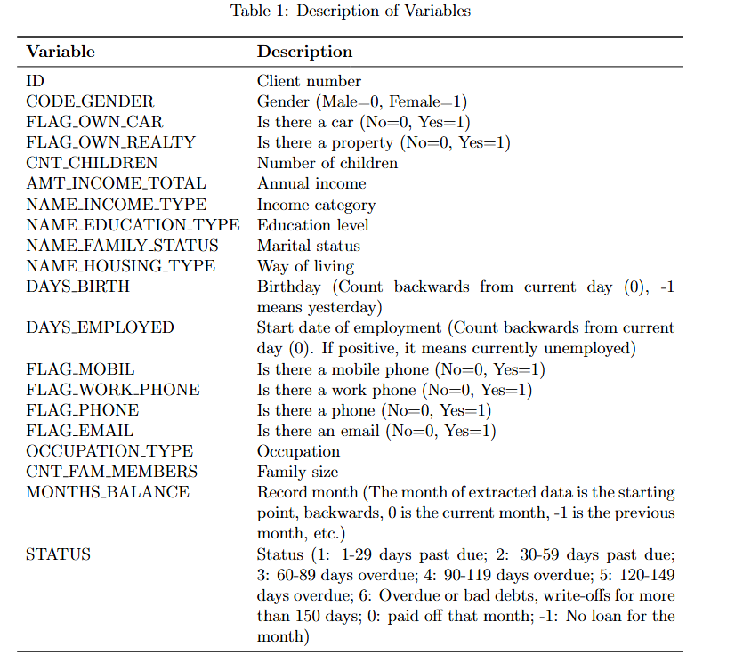
EDA
EDA-data
IDA Template

Slide 5
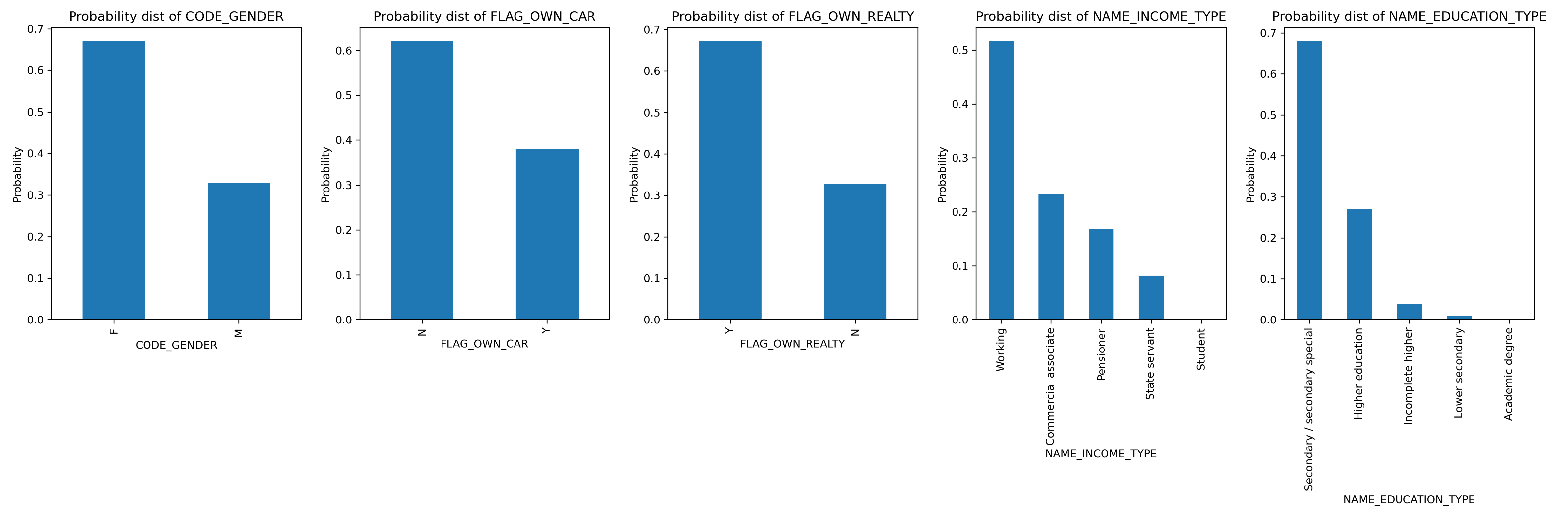
EDA
EDA
Categorical variable
IDA Template

Slide 6

EDA
EDA
Categorical variable
IDA Template

Slide 7

EDA
EDA
Categorical variable
IDA Template

Slide 8
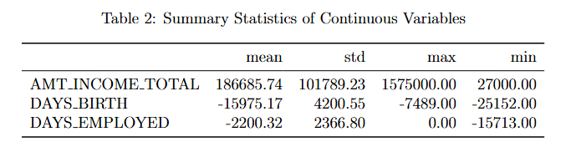
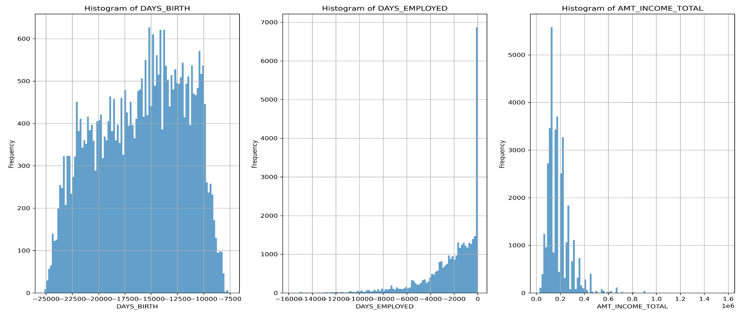
EDA
EDA
Continuous variable
IDA Template

Slide 9
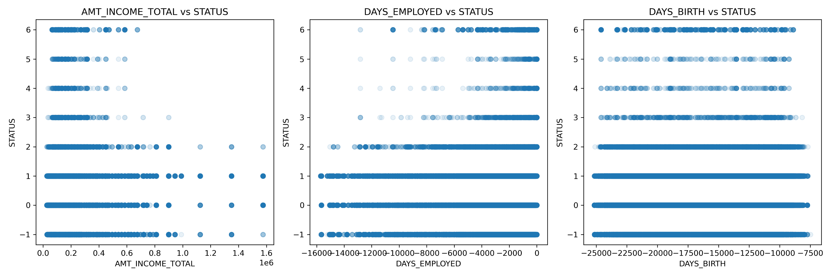
EDA
EDA
Scatter plot of STATUS and continuous variables.
IDA Template

Slide 10
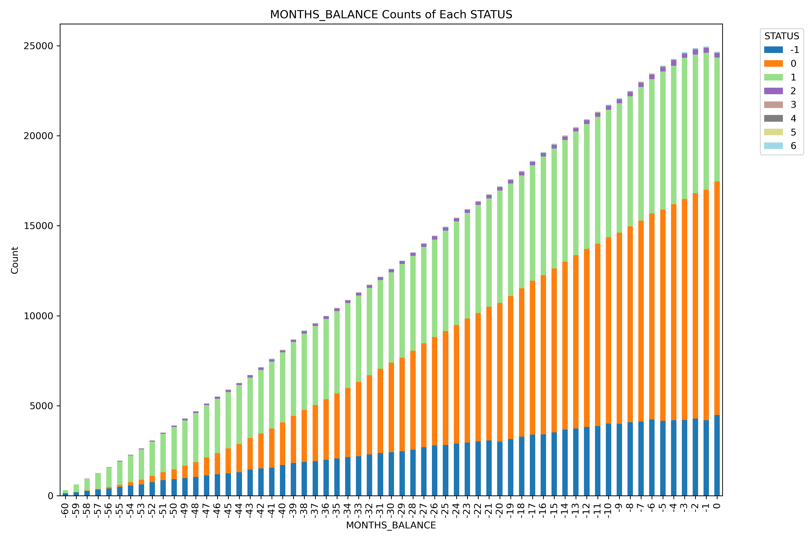
EDA
EDA
Stacked Bar Chart of STATUS by MONTHS BALANCE
IDA Template

Slide 11
STUDY PLAN
Process
Dataset: Credit Card Approval Prediction Dataset
data cleaning, create new features(dummy)
Train and optimize machine learning models
Evaluate model performance
Conclusion
EDA
IDA Template

Slide 12
STUDY PLAN
Methodology
Model
Goal
Predict the likelihood of an applicant being a 'good' or 'bad’
client.
Logistic regression
Decision trees
Random forests
XGBoost
IDA Template

Slide 13
Credit Card Default Prediction
Ting Siou, Chen
20241118 Credit card default prediction

